Slide 1
Information about kapacity kpis
Advisory groups meeting
14th April 2021
www.rfc7.com | coss@rfc7.com

Slide 2
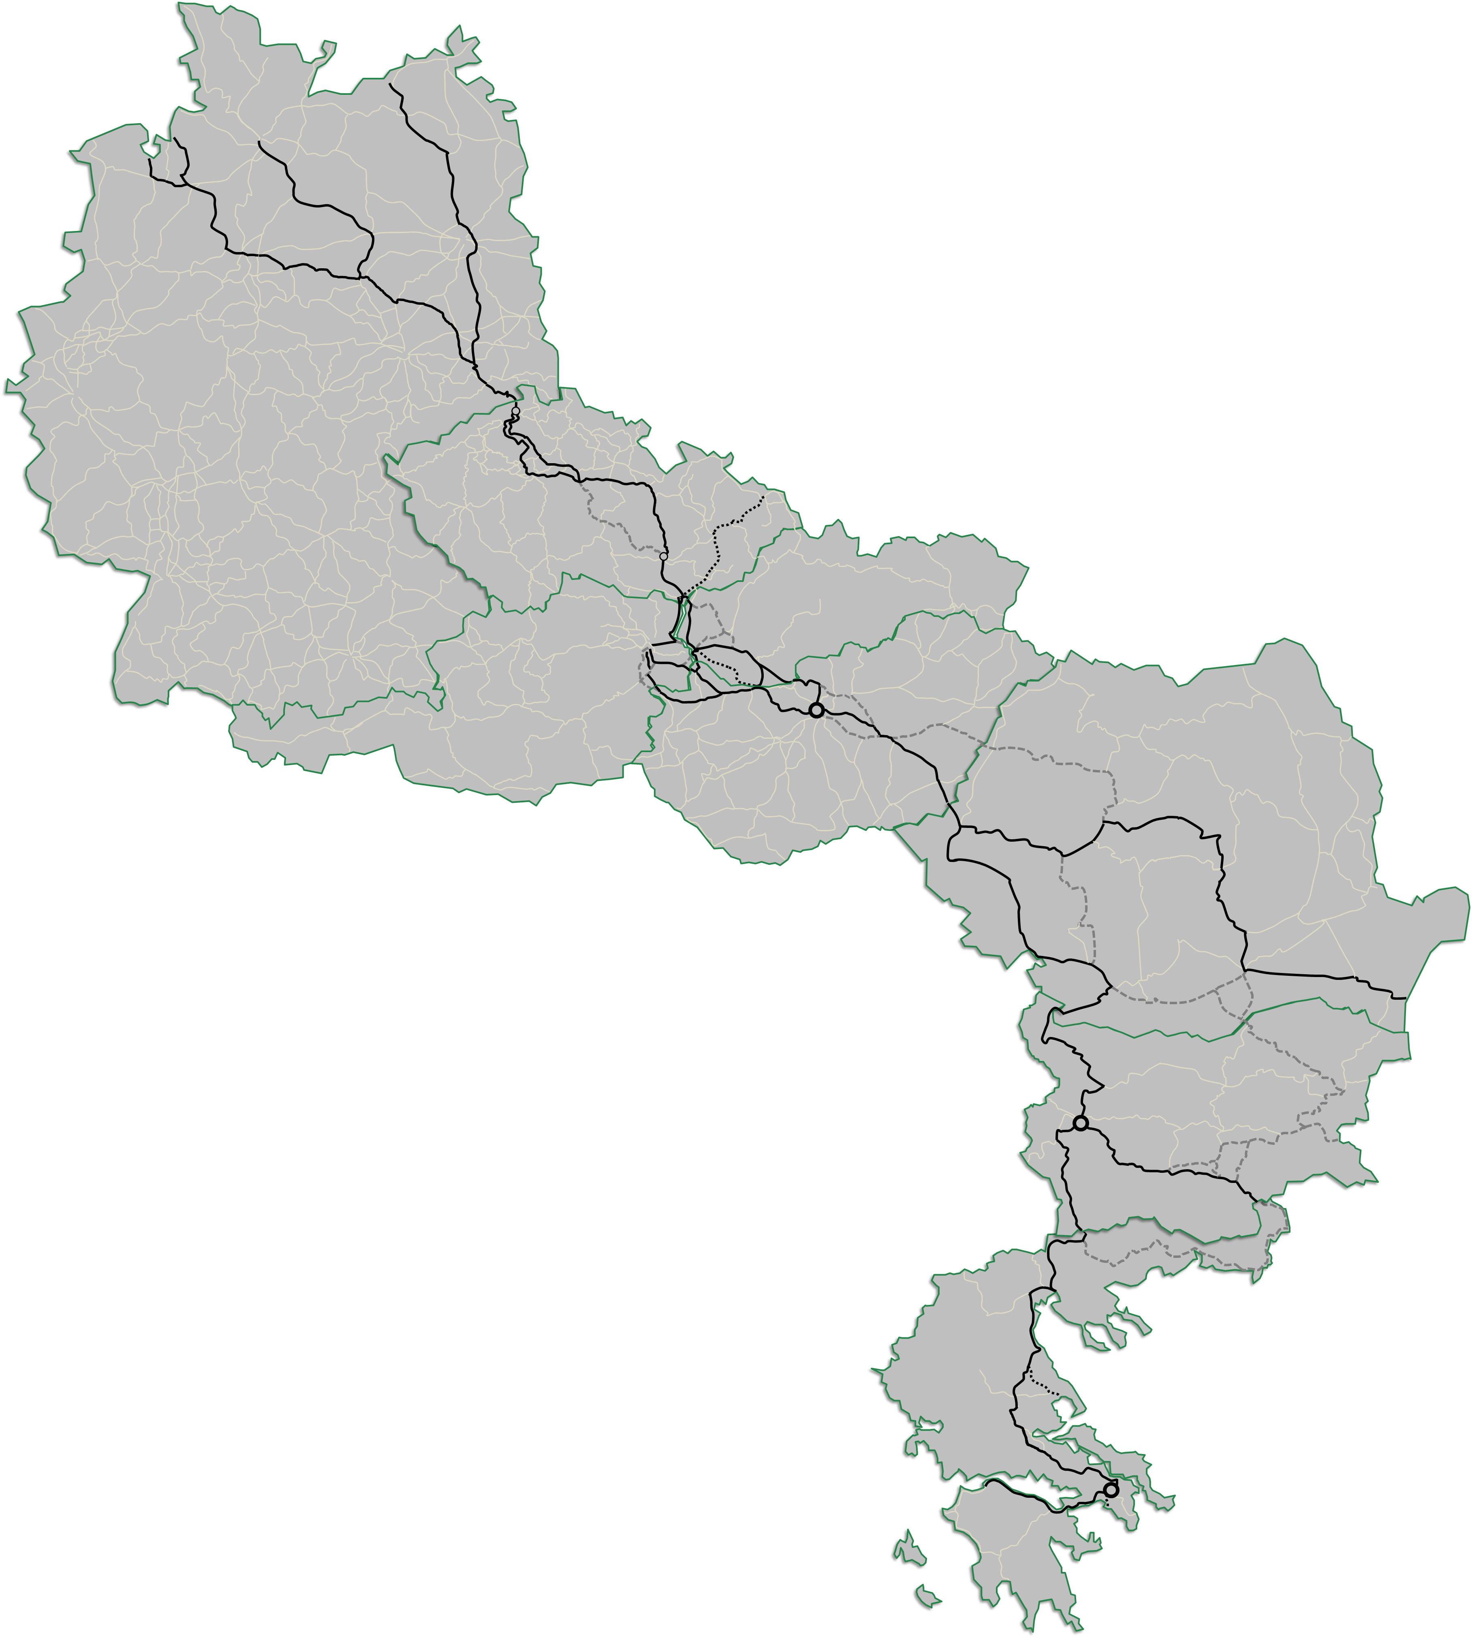
Pre-arranged Paths offer for timetable 2022
Praha/Kolín
Common offer with RFC 8
8 pairs of PaP per day
Connection to Rostock; Hamburg; Bremerhaven/Wilhelmshaven
Břeclav
9 pairs of PaP per day
Connection to RFC 5
Connection to:
Praha/Kolín; Wien; Bratislava/Dunajská Streda; Budapest/Soroksár; Curtici
PaPs uploaded to PCS on 11th January (X-11).
Curtici
18 pairs of PaP per day
Connection to:
Brno; Budapest/Soroksár; Sopron/Hegyeshalom; Bucharest; Constanta Port; Svilengrad
2 week period for fine-tuning (checking of errors, TCRs).
Sopron/Hegyeshalom
Common offer with RFC 9
18 pairs of PaP per day
Connection to RFC 11
Final catalogue published on website and CIP on 25th January.
C-OSS Newsletter sent out on 08th February
Craiova
12 pairs of PaP per day
Connection to: Sopron/Hegyeshalom; Bucharest; Constanta Port; Galati; Sofia; Svilengrad; Thessaloniki Port; Piraeus Port
Svilengrad
Connection to Turkey

Slide 3
Pre-arranged Paths offer for timetable 2022
 | DB Netz | SŽCZ | ŽSR | ÖBB | VPE | CFR | NRIC | OSE | SUM
TT 2021 | 1 881 895 | 2 459 475 | 1 351 572 | 207 495 | 5 496 003 | 4 740 656 | 1 748 998 | 470 019 | 18 356 112
TT 2022 | 4 407 641 | 2 517 227 | 1 642 448 | 337 359 | 7 368 792 | 5 935 326 | 2 462 948 | 471 824 | 25 143 565
Evolution | +134,2% | +2,3% | +21,5% | +62,6% | +34,1% | +25,2% | +40,8% | +0,4% | +37,0%

Slide 4
Pre-arranged Paths offer for timetable 2022
+25%

Slide 5
Commercial speed of paps for timetable 2022
No major changes compared to last year
Competitive
Functional
Not Competitive

Slide 6
Ratio of allocated capacity timetable 2021
RFC border area | Reference IM | Volume of allocated international freight trains for the yearly timetable (no. of running days) |  | of which allocated by the C-OSS |  | KPI
 |  | TT2020 | TT2021 | TT2020 | TT2021 | TT2020 | TT2021
Bad Schandau - Děčín | DB Netz | 52825 | 48995 | 260 | 3949 | 0,5% | 8,1%
Břeclav - Kúty | SŽCZ | 31250 | 27640 | 2600 | 2235 | 8,3% | 8,1%
Břeclav - Hohenau | ÖBB-I | 15384 | 15763 | 0 | 516 | 0,0% | 3,3%
Nickelsdorf - Hegyeshalom | ÖBB-I | 19314 | 19293 | 0 | 206 | 0,0% | 1,1%
Baumgarten - Sopron | ÖBB-I | 4365 | 2864 | 0 | 0 | 0,0% | 0,0%
Rusovce - Rajka | ŽSR | 5171 | 5621 | 0 | 0 | 0,0% | 0,0%
Komárno - Komárom | ŽSR | 4042 | 4598 | 363 | 0 | 9,0% | 0,0%
Štúrovo - Szob | VPE | 5280 | 4826 | 2600 | 2285 | 49,2% | 47,3%
Lőkösháza - Curtici | VPE | 11024 | 12324 | 7852 | 9127 | 71,2% | 74,1%
Biharkeresztes - Episcopia Bihor | VPE | 1040 | 1144 | 321 | 312 | 30,9% | 27,3%
Golenti - Vidin tovarna | NRIC | - | - | - | - | - | -
Giurgiu - Ruse | NRIC | 6136 | 7093 | 832 | 1552 | 13,6% | 21,9%
Kulata - Promachon | OSE | 520 | 120 | 0 | 0 | 0,0% | 0,0%

Slide 7
Further information available at:
https://rne.eu/rail-freight-corridors/rfc-kpis/
www.rfc7.com | coss@rfc7.com

