Slide 1


Advisory groups
Railway undertakings / terminals
14 April 2021

Slide 2
Welcome and opening
Approval of the agenda
9.30
9.40
9.40
10.10
Summary report from the spokesperson
Expectations and proposals from the business partners
Feedback from the RFC Information about the issues discussed at the previous meeting
& recent news
10.10
10.25
10.25
10.50
Capacity allocation
Information about capacity KPIs
Initiative of terminal integrated pre-arranged train paths
11.00
11.10
New satisfaction survey scheme
Feedback
11.10
11.25
New initiative
Volatility of actual departure time from terminals
Issues-logbook
Feedback from the railway undertakings about deregulation measures
Economic potential for Issues Logbook (ILB) interoperability issues
11.25
12.00
12.00
12.15
Short feedback
on the proposals suggested by the spokesperson
12.15
12.30
AOB

Slide 3


17 March 2021: concept envisaged at RU meeting in București
23 March 2021: CFR notified MÁV about the initiative
8 April 2021: MÁV gave feedback
General approach supported
Technically, implementation via IMCOMM suggested
Pre-notification of trains HU / RO
New procedure proposed by RO RUs
Further development of the pre-notification scheme already applied by MÁV
Creating a standard format for information;
Defining fixed time periods, when the information will be changed:
at every 6 hours (2 times / shift);
Input from MÁV: details of trains to pass the border
Input from CFR: details of processing each train
Output: RUs receive accurate information about the planned traffic for the upcoming 6 hours

Slide 4
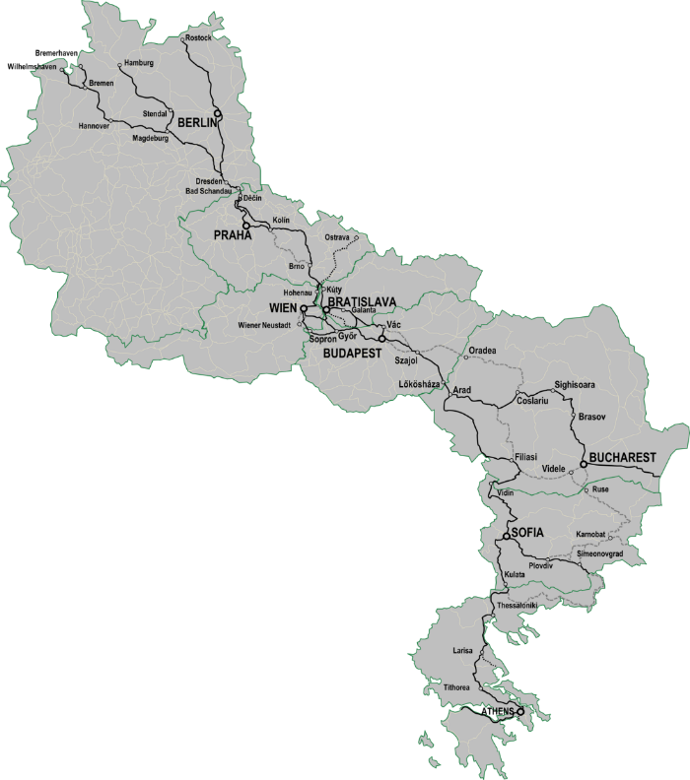
Train linking
Outcome
Improvement during the period
Follow-up
Presentation by RCC
06
01
Measured
Number of link candidates
Locations
9 border crossings
05
02
Period
Last autumn
Method
Provided by RailNetEurope
04
03

Slide 5

Specific case: performance of trains to Railport Arad
Some good news…
Railport Arad at the heart of vital cross-section of RFC OEM
MÁV changed traffic procedures for services to Railport Arad
Continuous monitoring
Empiric parameters show improvement
03
March: 40 trains
Average waiting: 103 minutes
02
February: 42 trains
Average waiting: 235 minutes
01
Monitoring period:
Between 18. and 28. day of the month

Slide 6
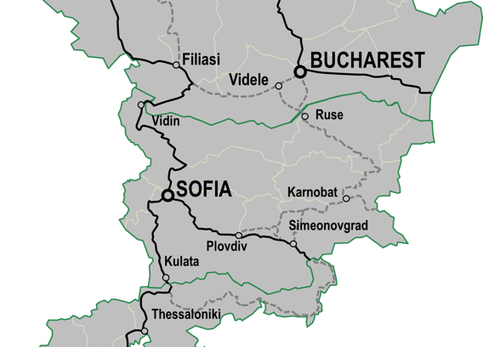
Long trains between
Ruse – Svilengrad
STARTING POINT
Relatively shorter train length allowed due to terrain constraints
Trains regularly come with excess length
Current practice foresees cancellation of existing path and requesting special consignment
POTENTIAL WAYS AHEAD
Part of development plan, but not yet scheduled for implementation
Current provisions deem PaPs with long trains as discriminatory
  Executive Board intervention is sought
Simplification of declaring special consignment
  Comparison with other IMs
  Customer opinion sought

Slide 7
Performance regime of DB Netz AG
Timing
New scheme first introduced to passenger traffic (1 June 2019)
System for freight traffic
applied later to allow discussions with the market
Finalization in 2019,
application with NS 2021
(see NS 2021 6.5.21.).
New scheme
Consultation
5 dedicated on-site workshops
in early to mid 2019
with representatives of all major freight RUs and associations
Numerous bilateral meetings, phone-calls and workshops related to the interpretation of guideline 420.9001
Approval procedure by German regulatory body
Timing
Consultation
Added value
Compatibility
Advantages for RFC-trains
Definition of RFC-trains
PaP trains have (partially) been provided with extra product characteristics on RFC OEM
Demand from market not yet solid and single
Compatibility
Performance schemes of neighbouring IMs were screened and taken into account

Slide 8
Performance regime of DB Netz AG
Delay from other network
Delay codes and application regulated by guideline 420.9001 International trains with delayed entry generally subject to code 41, which is neutral and
not subject to penalties.
In case code not deemed as precise, claim can be put forward (NS 2021 6.5.1.2)
New scheme
Train categories
‚sensitive to punctuality’
‚not sensitive to punctuality’
Categorisation initially requested by Rus
Categorization done by the RU itself.
Inherited delay
Categories
Definition
Bonuses
‚Last operating location’
Measurement point for final punctuality
Last location operated by DB Netz,
e.g. where the train path ends.
Potential bonuses
Balance of system is ensured through penalties applicable for both contracting parties
IM is net payer currently

Slide 9

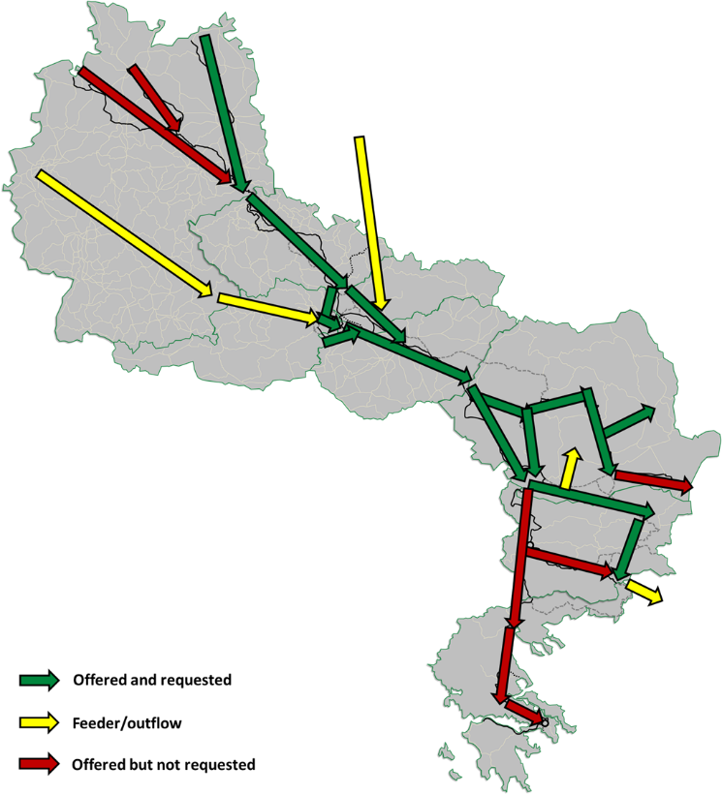
Relation with the Turkish railways (TCDD)
STARTING POINT
Considerable goods traffic on RFC OEM is moving on towards the network of TCDD
Certain issues to be optimised were notified regarding the border crossing towards Turkey
POTENTIAL WAYS AHEAD
TCDD initially preferred first contacts on governmental level
There was no consent within the Executive Board
Negotiations recently re-established under the umbrella of relevant IM
(9 April 2021)
TCDD welcomed the cooperation, we may put forward initiatives

Slide 10
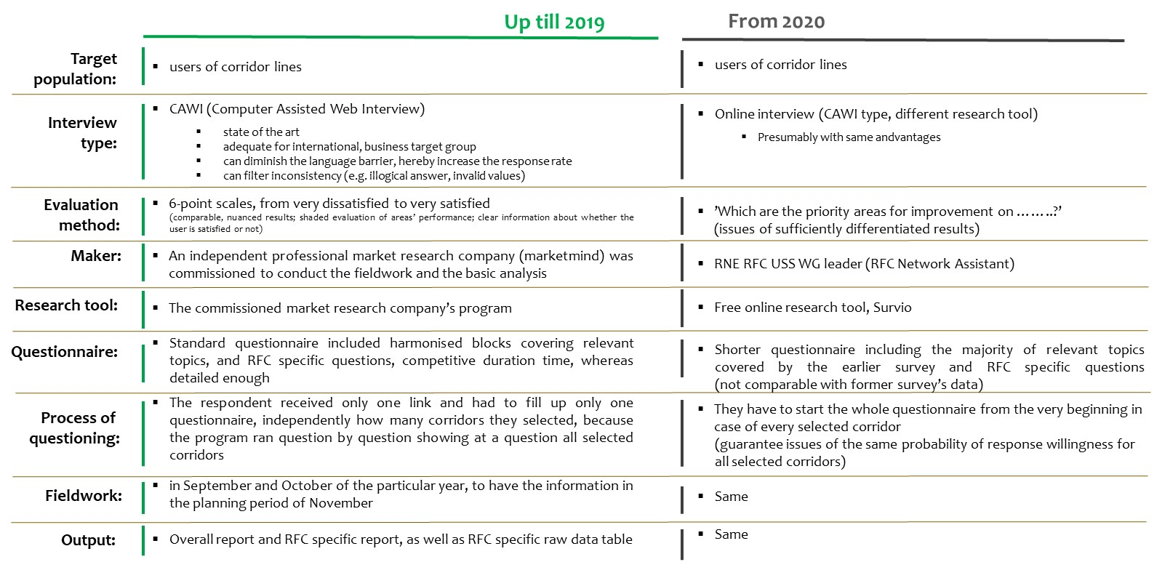
Comparison of Methodologies

Slide 11
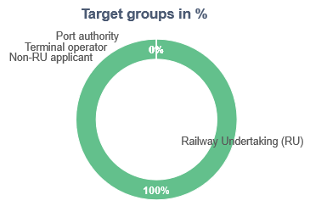
The sample and a possible way of the analysis
RFC OEM had 12 respondents
All of them are RUs
33% decrease in the number
of interviews
It is a small sample size for a quantitative analysis, therefore we should analyse it as a qualitative sample focusing on the pattern and congestion of the answers and the main messages

Slide 12
The priority areas for improvement
The chart shows the number of respondents who selected the particular element.
The other elements were not selected.

Slide 13
Did you feel any improvements in coordination and communication of planned Temporary Capacity Restrictions (TCR) on RFC OEM (RFC7)?
RFC OEM specific question

Slide 14
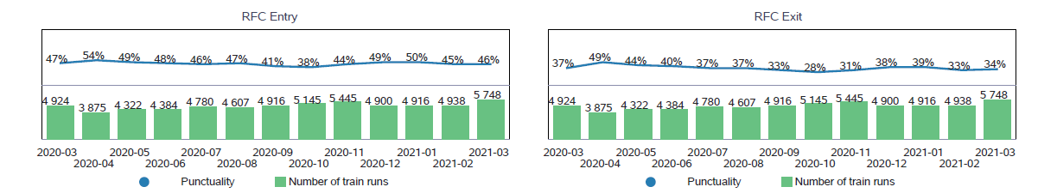
Analysis
What factors lead to the double gap
to full puncutality?
Volatility of actual
departure times
Gap difference
Origin – destination (~10%)
Origin – full punctuality (~40%)
Terminals
Neutral stakeholders

Slide 15
Deregulation measures
Romania
Regulation No 1908
of the Minister of Transport, Infrastructure and Communication
From 21 October 2020
Seeking to simplify and facilitate the application of UIC’s ATTI convention, established detailed rules.
Hungary
Regulation No 39/2020.
of the CEO of MÁV
from 23 February 2020
(applicable from 1 August 2020)
Repealing Appendix No 13 of Regulation F.2
Thereby reverting to the provisions of RID, as regards the usage of buffer wagons
(eradicating the national rule)
National rules
European legislation
Issues log
Seeking deregulation among national rules
Agenda point No 2 at the Issues Log Book plenary (24 March 2021)

Slide 16

Opportunities & threats
All external costs of transport within the EU will be covered by the transport users at the latest by 2050.
By 2030, there will be at least 80 000 zero-emission lorries in operation.
By 2050, nearly all cars, vans, buses as well as new heavy-duty vehicles will be zero-emission.
By 2030, automated mobility will be deployed on large scale.
Scheduled collective travel under 500 km should be carbon-neutral by 2030 within the EU.
Clear, but ambitious
Rail freight traffic will increase
by 50% by 2030
and double by 2050
Basis is the traffic level of 2015
By 2030,
freight transport will be paperless
Target
Competition

Slide 17


