Slide 1
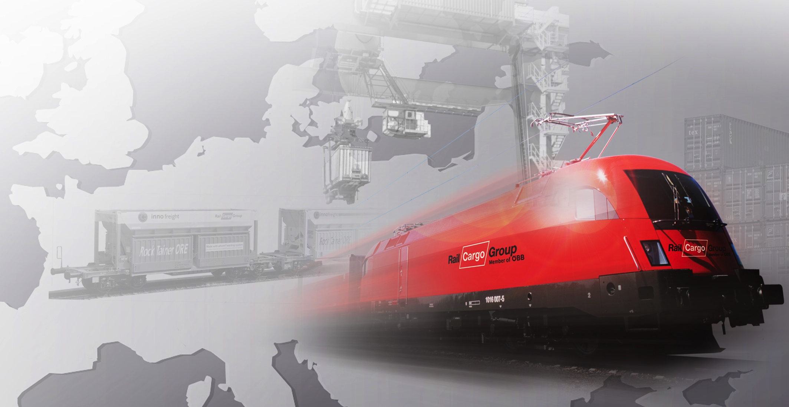
Expectations and suggestions of Railway Undertakings
Gyula Farkas PhD.
Representative of RUs along O/EM Corridor,
RAG7 meeting, Budapest - onine, 14th April 2021

Slide 2
RCG corridor train performance along RFC7 (2021.01.01-03.31)
Train number | Origin | Destination | Interval | Order | Run
 | station |  |  | Number of corridor train
40704 | Kapikule | Sopron | 2021.01.01-03.31. | 90 | 80
40705 | Sopron | Kapikule | 2021.01.01-03.31. | 90 | 79
40620 | Kapikule | Vienna | 2021.01.01-03.31. | 25 | 25
40621 | Vienna | Kapikule | 2021.01.01-03.31. | 25 | 24
Total |  |  |  | 230 | 208
159 train *1617 km ~ 257 103 trainkm, 6.15 trainpairs / week Sopron – Kapikule and return
49 train *1672 km ~ 81 928 trainkm, 2 trainpairs / week Vienna – Kapikule and return
~8 trainpairs/week, ~339 000 trainkm / 1.Jan-31.March 2021

Slide 3
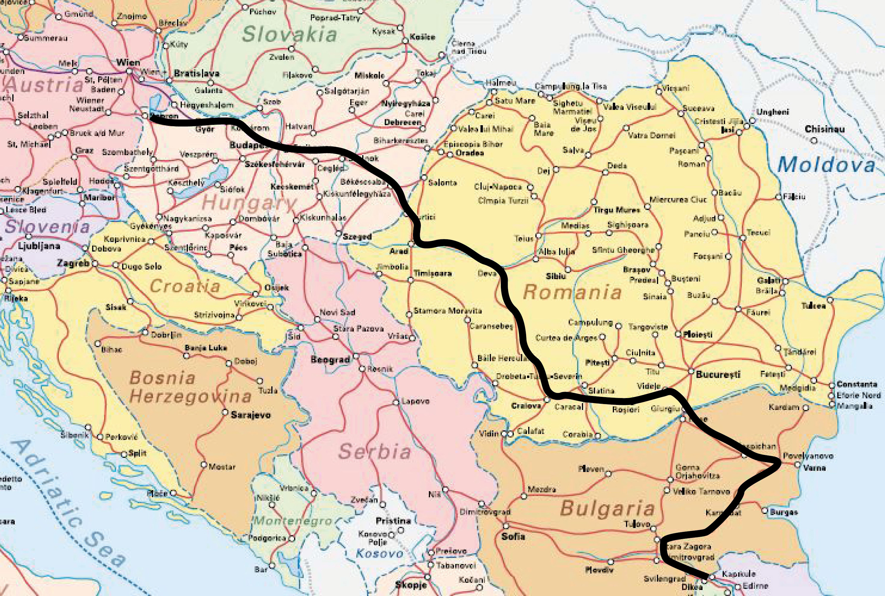
RFC7: Sopron – BILK – Kapikule (exp: ~3,5 day, ~20km/h; act: ~3,5-5 day ~15km/h)
Ordered train parameters (Southbound): 1600 t, 575 m
Average train parameters (Southbound): 1200-1400 t, 520-540 m
Curtici border – long waiting time in both directions
Arad – Simeria: reconstruction works
Helping engine through the Carpatians
Single track line section in Hungary
Videle – Ruse: diesel traction
Two loco drivers needed in Romania
Change direction of train in BG
Single track line sections in RO
Two loco drivers needed in Bulgaria
Single track line sections in BG
Ordered train parameters (Northbound): 1400 t, 575 m
Average train parameters (Northbound): 900-1200 t, 520-540 m

Slide 4
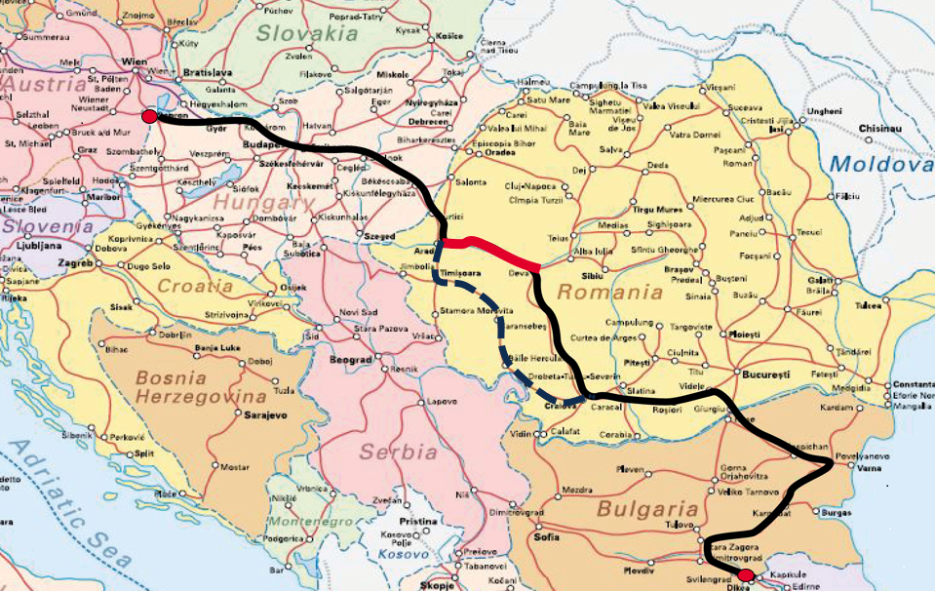
RFC7: Sopron – BILK – Kapikule (exp: ~3,5 day, ~20km/h; act: ~3,5-5 day ~15km/h)
Arad – Simeria: reconstruction works
Continuous closure on one track of the two
Only one or two aside tracks are available at stations
Additional trains can not be run by RUs, remaining capacity was fully allocated for RUs
Total track closures at periods, announced only some weeks before
These circumstances are making the traffic completely unplannable

Slide 5
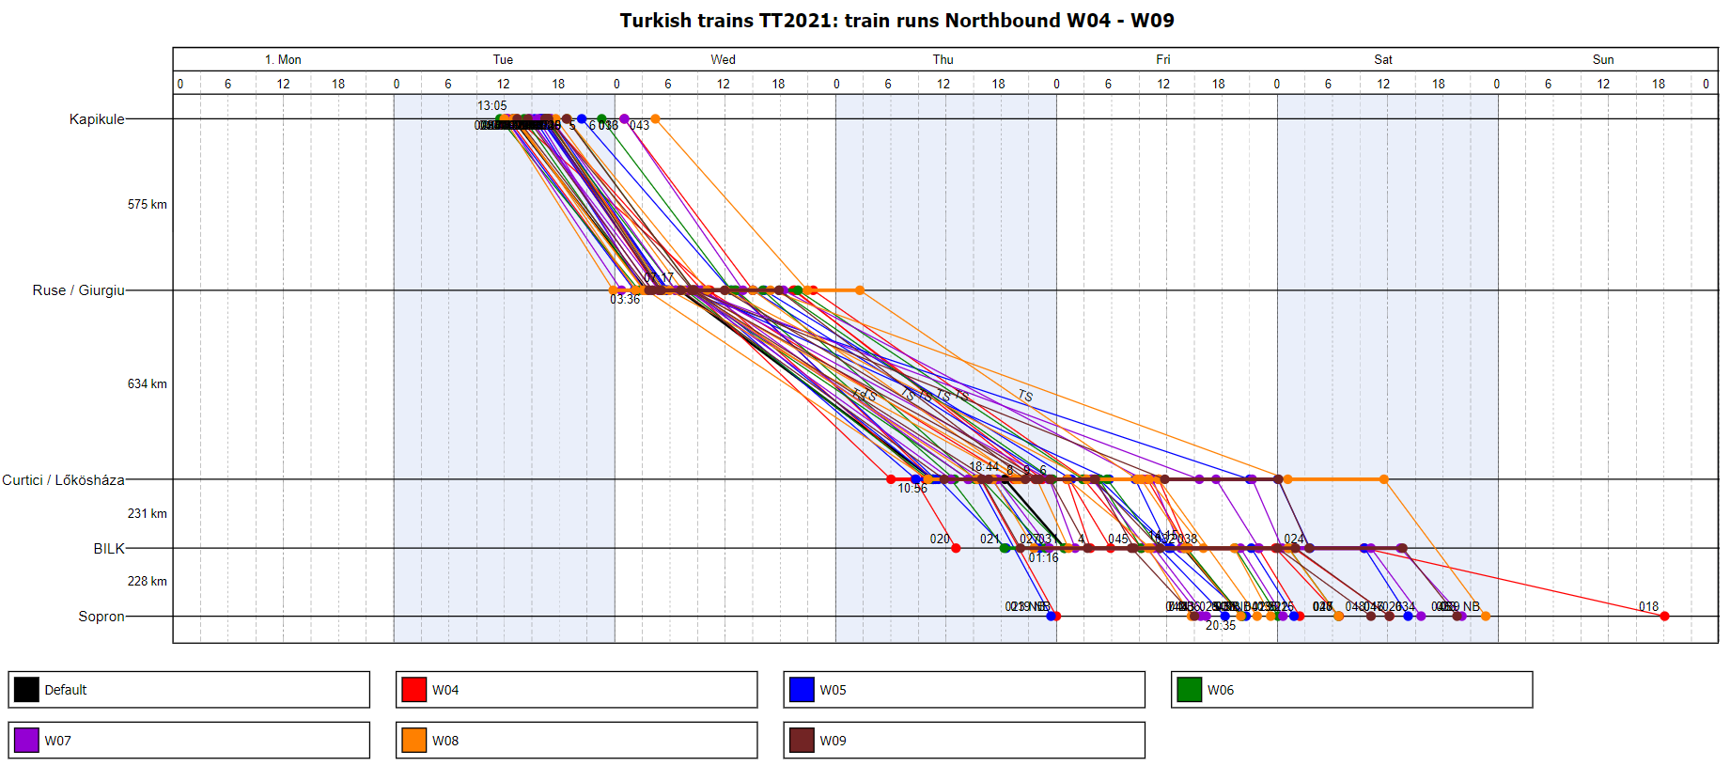
Average speed of RCG corridor trains (4-9 week 2021)
Some trains were rerouted via Caransebeş instead of Simeria
Average speed: 11km/h – 29km/h (in Romania)
Transit time: 22h – 58h (in Romania) Request: 36h
Transit times decreased a bit, but 1/3 of our trains are over 36 hours!

Slide 6
Transit time - timetable vs. transit time - real (Romania)
Craiova – Curtici automotive train => 24 h
Curtici – Craiova empty automotive train =>16h
Ciumesti – Curtici automotive train => 29 h
Curtici – Ciumesti empty automotive train =>31h
Cerkezkoy – Munchen BSH train => 27 h
Rosenheim – Cerkezkoy BSH train => 21 h
Curtici – Catusa loaded coke train => 45 h
Catusa – Curtici empty coke train => 41 h
Craiova – Curtici automotive train =>38 h
Curtici – Craiova empty automotive train => 22 h
Ciumesti – Curtici automotive train => 37 h
Curtici – Ciumesti empty automotive train => 35 h
Cerkezkoy – Munchen BSH train => 46 h
Rosenheim – Cerkezkoy BSH train => 37 h
Curtici – Catusa loaded coke train => 74 h
Catusa – Curtici empty coke train => 63 h
Additional 4-16 hours (average /train)

Slide 7
How could be improved the transit time of Curtici border crossing?
Long Medium Short
Increase transparency of border crossing procedures between CFR, Border Police, RUs (to be decreased waiting time of BP activity)
Direct email communication between CFR&MAV/RUs dispatchers coordinating the Curtici-Lőkösháza border
CFR&MAV dispatcher plan together running of granted corridor trains in Curtici for the next 6/12 hours (providing corridor train priority)
Information on TCRs for RUs according to VII Annex 2012/34/EC
NSAs (RO-HU) cooperation on improvement border crossing procedures (eliminate different national rules and regulations on e.g. braking, train composition)
The Governments of HU and RO to agree common HU and RO teams for Police Control at Curtici Border
Infrastructure development (double tracking) between Békéscsaba- Lőkösháza gr.

Slide 8
Workshop on improvement of rail freight transport along OEM and RhD RFC
Participants:
OEM and RhD RFC ExBo Member ministries
RFCs’ Managing Directors (OEM and RhD)
Infrastructure Managers and C-OSSs, Railway Undertakings
NSAs
When: has not been fixed yet
Topics:
Speeding up the checks by the border police (simultaneous train inspections instead of one train after the other – evaluate the provision of more staff)
How to make MAV and especially CFR to stick to the requirements of Annex VII when planning and communication TCRs – including the ensuring of minimum path availability on the rerouting lines of the Romanian part of the RFCs
Harmonise rules and procedures in train operations wherever possible (follow-up on the Issues-Log initiative of the EC/ERA)

Slide 9
Issues Logbook – RUs contribution along O/EM Corridor
Title | RUs contribution
Braking | Discussion paper was carried out by RCG
Train composition - Buffer wagons* | Discussion paper was carried out by RCG
Technical checks at border stations | Discussion paper was carried out by RCG
Mandatory checks in MS | Discussion paper was carried out by RCG
*Traffic regulation was modified in Hungary according to RID (01.08.2020)
Consequency: Additional technological time, HR and wagon resources, costs for RUs
Decrease competitiveness and capacity at border stations
RUs asking
Harmonise different above mentioned national rules

Slide 10
Regulatory and operational interoperability
Romania: Codes of good (best) practices are handled by Transport Ministry and it can be modified in a difficult manner – solution: these codes have to be part of RDN (reference document of network) under handling by IM (Transport Ministry)
Romania, Bulgaria: Number of loco drivers (2 loco drivers necessary in RO and BG) – solution: technical investment and to modify the legislation (Transport Ministry)
Border crossings at Hegyeshalom (HU), Curtici (RO) and Ruse (BG) is critical (solution: prioritisation for interoperable locomotives and for RFC7 corridor trains) – solution: Develop and sign the bilateral cross-border agreements (Transport Ministries concerned) and IMs’ agreements
Regulation about the differences in signalling systems of CFR and MÁV for Curtici – Lőkösháza section, in RO-HU direction. But it is not possible to change locomotive drivers in Lőkösháza instead of Curtici to decrease stopping time. (missing MÁV-CFR agreement on language issue for loco drivers at border crossing procedures)

Slide 11
Main expectations/ key issues along OEM Corridor
Issue | Impact on | Term | Details
Coordination of infrastructure works (SPP3) | Competitiveness Attractivity Productivity Profitability | Short term | Information on planned track closures and infrastructure projects, providing alternative routes, compensation (additional charges) Border crossing procedures
Harmonisation of national regulations (SPP5, SPP10, +) |  | Medium term | Traffic rules, priority rules, NSs, PRs and ATTI procedures (RO, GR)
Improving train parameters (SPP7) |  | Long term | Length of train* (740m), axle load (225kN), electrification, double track *pilot in BG, RO 575m+loco

Slide 12
Opportunities and threats along O/EM Corridor
Traffic flows | Opportunities, threats | Term | To do
Piraeus (GR) – RCT-BILK (HU) /Bratislava (SK)/Pardubice (CZ) and return Traffic flow: 5 trainpairs/week, 1200 gross tons of train | Currently, via North Macedonia-Serbia route | Medium term | Competitive offer (transit time, charge, reliability)
Sopron/Vienna - Kapikule RCG corridor train (and return) Traffic flow: 8 trainpairs/week, 1300 gross tons of train | Rail: AT-HU-RO-BG-TR TR-BG-SRB-HU-AT Short sea: Trieste (IT) Rail: IT-AT | Short term | Transit time (36 hours), priority rules, ATTI procedures (RO)
Czech Rep – Germany 6 trainpairs/day PaP capacity Expectation: 22 trainpairs/day PaP capacity, 1300 gross tons of train | Increase corridor train performance | Medium term | Provide enough volume of PaP capacity according to RUs requirements
GR: Thessaloniki-Strimonas – single track, diesel, 126km between stations (no IM staff, no working signalling system)

Slide 13
Expectations - conclusions
to provide priority for corridor trains at operational level – does not work in Romania
to decrease border stopping time in Curtici
more transparent operation (BP-IM), introducing ATTI for corridor trains
to protect granted corridor train paths against capacity restriction – Arad-Simeria serious capacity restriction for years (During total line closures, on the alternative route, not to be approved another daily closure (except accident)
to increase PaPs (timetable) offer according with RUs requests (CZ-DE sections)
to start pilot project for harmonised train length at least in RO, BG 575m+loco
to provide max. 36 hours transit time (including police controll) via Romania
Turkey/Bulgaria-CEE via Serbia/Croatia is more competitive against via Romania (shift of train run has began)

Slide 14
Expectations - conclusions
Expected benefit
to monitor and evaluate tendencies (ExBo/MBo), monthly, inform concerned RUs
to work out and force into language for loco drivers (MÁV, CFR), therefore Lőkösháza can not be used as handover station (scare capacity of Curtici can be decreased)
to harmonise the different traffic regulations and rules (Issues Logbook), to validate additional costs of different traffic rules and regulations, to speed up harmonisation, cancellation policies
better information flow and monitoring - info on operational KPIs - regarding circulation of corridor trains
to strengthen electricity (energy) system (using efficient electric-dynamic brake of loco)
to deal with opportunities and threats from competition perspective (advantages of other modes (rail, road, iww) in terms and conditions & prices /charges
to cooperate with RhD RFC on key issues of RUs (dwelling time, TCR, harmonisation)

Slide 15
Thank you for your attention!

