Slide 1
Introduction of terminal integrated capacity offer
Advisory groups meeting
14th April 2021
www.rfc7.com | coss@rfc7.com

Slide 2
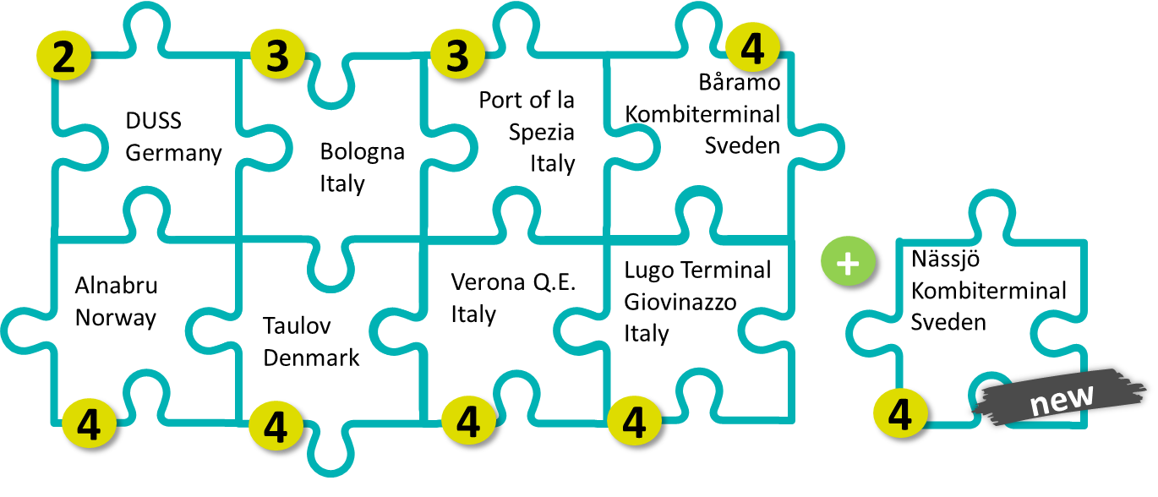
Terminal integrated capacity offer - tico
Sector Statement Group Priority 2: New concepts for capacity offer on RFCs
The revision and updating of the capacity concepts offered via the Rail Freight Corridors is aiming to provide a capacity solution for each market requirement.
TICO is an official capacity product on RFC3 (Scan-Med) from Timetable 2021 allowing customers to request for terminal capacity together with pre-arranged paths (PaPs) in one step.
X
Applied TICO Level (see details on next slide)
Further information available at:
https://www.scanmedfreight.eu/scanmedrfc/services/capacity-offer/tico/

Slide 3
Terminal integrated capacity offer - tico
C-OSS as facilitator of information exchange
1
By the Beginning of July, the C-OSS forwards to the Terminals the train information on Draft TT for the trains that can be expected in Terminals with permission by the applicant.
low
C-OSS as common Post-Box
Applicants can place requests for Terminal Capacity in one step, together with the PaP requests. The C-OSS acts as a common Post-Box for both requests for PaPs and for Terminal Capacity. Pre-Booking and Allocation of the Terminal Capacity is still conducted by the concerned Terminal.
2
Publication of Free Terminal Slots
Level of commitment
3
C-OSS publishes free Terminal Slots (no preliminary coordination with the PaP times) in the PaP Catalogue. Once an Applicant has applied for a published slot, the request for the Terminal Capacity will be forwarded to the Terminals for pre-booking and allocation.
Publication of Coordinated Terminal Slots and integrated offer
C-OSS publishes in the PaP Catalogue Terminal Slots which were coordinated with the PaP times. Once an Applicant applied for a PaP and a coordinated Terminal Slot, the C-OSS decides which Terminal Slot is to be pre-booked to which applicant. Final Allocation of the Terminal Capacity is still conducted by the concerned Terminal.
4
high
Further information available at:
https://www.scanmedfreight.eu/scanmedrfc/services/capacity-offer/tico/

Slide 4
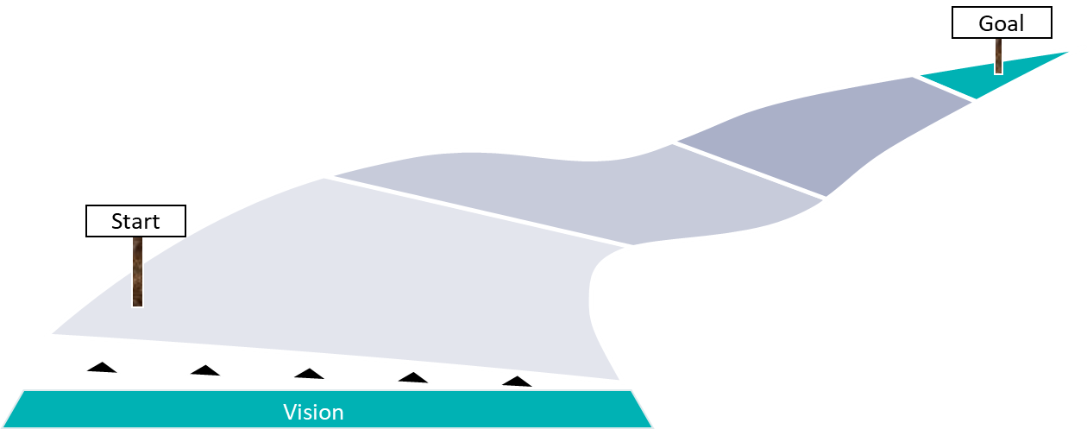
Terminal integrated capacity offer - tico
More integrated approach
(interfaces between IM, RU and Terminal systems – TSI readiness)
Use TICO not only for annual Timetable requests
(RC-request, ad-hoc request)
Extension of Product to other
Terminals and Corridors
RFC 5 plans to join TICO in 2021 (two interested terminals already)
RFC 7 ?
Further information available at:
https://www.scanmedfreight.eu/scanmedrfc/services/capacity-offer/tico/

Slide 5
Thank you for your kind support!
www.rfc7.com | coss@rfc7.com

