Slide 1
Task force report
Rajka – Rusovce
GYSEV – ŽSR

Slide 2
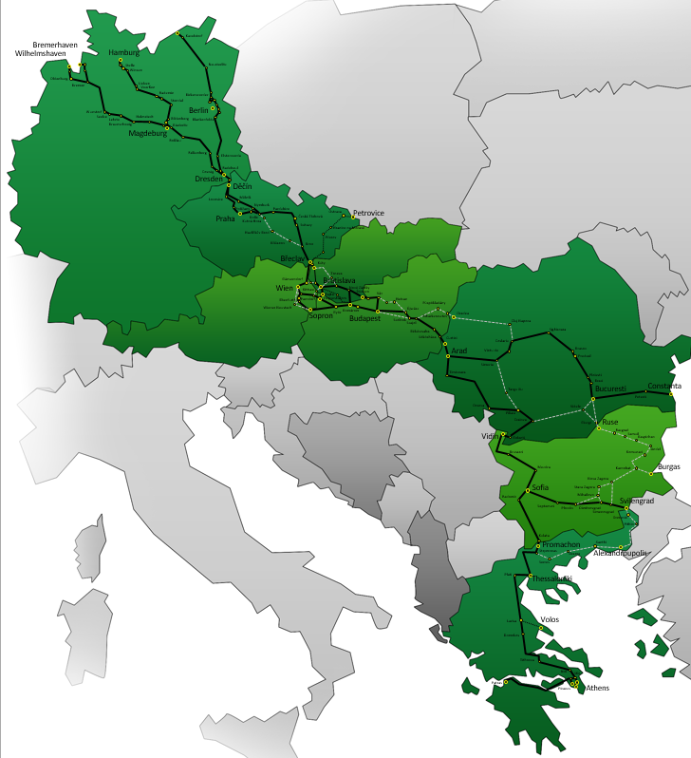
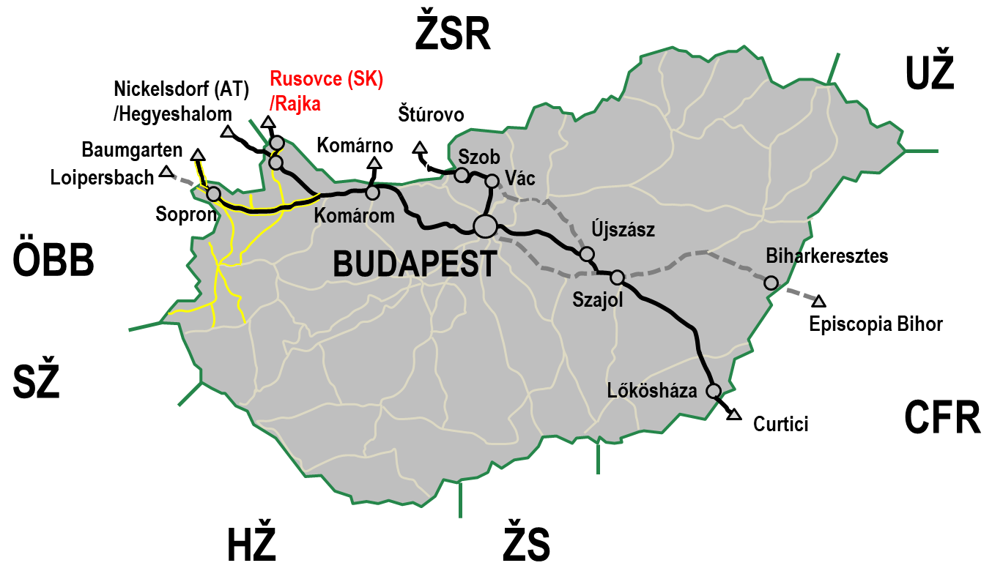
Location
Notes:
Please indicate with the arrow below the exact location on the map.

Slide 3


Task force
  Task force leader IM: GYSEV (Mr József Bencsics)
  Participating IMs: GYSEV, ŽSR
  Participating RUs:
  Last meeting: 24 February 2022
    METRANS
    ZSSK CARGO
    RCH
    GYSEV Cargo
    PKPCI
    CER
    TrainHungary

Slide 4
Figures
Source: National system
There were a partial closuresin 2018 due to bridge reconstruction
Notes:
Please insert Yearly traffic flow report here according to the sample.
Please indicate the source of data.
Source: TIS/National system

Slide 5
Average dwelling time
Dwelling time: stable trend, general decrease
Facts
  Distortion due to ad-hoc trains or earlier arrivals
  Longer waiting times upon RUs’ request
  Changes in process time (e.g. increase of trusted handover)
Calculated values: time between scheduled arrival and departure + possible delays (beyond process time)
Initial calculations: yearly average below 120 minutes

